Slide 1
What we’ll discuss today
Agenda
Securing the API
Understanding API Authentication
Users, Groups, and Service Accounts
Roles and RoleBindings
ClusterRoles and ClusterRoleBindings
Source:

Slide 2
What happens when an HTTP request hits the Kubernetes API?
Securing the API

Slide 3
High Level Workflow
Securing the API
HTTP request is processed by a chain of filters
Depending on the HTTP path the request is routed to an appropriate handler
The handler takes the request as well as context and retrieves as well as delivers object from etcd
Notes:
genericapifilters "k8s.io/apiserver/pkg/endpoints/filters"
genericfilters "k8s.io/apiserver/pkg/server/filters"

Slide 4
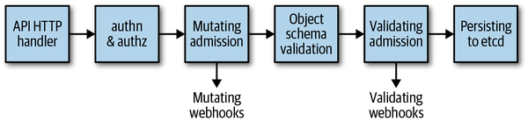
Securing the API
Notes:
Kubernetes uses client certificates, bearer tokens, an authenticating proxy, or HTTP basic auth to authenticate API requests through authentication plugins.

Slide 5
API HTTP handler and authn+authz
Securing the API
Chain of filters that either pass and attach respective information to the context or if filter does not pass return appropriate HTTP response; E.g. 401 for a failed auth
https://github.com/kubernetes/apiserver/blob/master/pkg/server/config.go#L722-L771
https://kubernetes.io/docs/reference/access-authn-authz/
Notes:
Authentication
In Kubernetes, every API call needs to authenticate with the API server, regardless of whether it comes from outside the cluster, such as those made by kubectl, or a process inside the cluster, such as those made by kubelet.
When an HTTP request is sent to the API server, the API server needs to authenticate the client sending this request.
The HTTP request will contain the information required for authentication, such as the username, user ID, and group.
The authentication method will be determined by either the header or the certificate of the request.
To deal with these different methods, the API server has different authentication plugins, such as ServiceAccount tokens, which are used to authenticate ServiceAccounts, and at least one other method to authenticate users, such as X.509 client certificates.

Slide 6
Admission, Validation, and Persistence
Securing the API
Admission
Mutate, validate, or both; mutate can set image pull policy, validation can verify namespace exists before creating object in respective namespace
Validation
Objects are checked to ensure they adhere to validation logic; i.e. string formats are checked to verify only valid DNS-compatible characters are used
Persistence
CRUD implementation; optimistic concurrency
https://kubernetes.io/docs/reference/access-authn-authz/admission-controllers/#what-does-each-admission-controller-do
Notes:
An admission controller is a piece of code that intercepts requests to the Kubernetes API server prior to persistence of the object, but after the request is authenticated and authorized.
Admission controllers may be "validating", "mutating", or both. Mutating controllers may modify the objects they admit; validating controllers may not.
Admission controllers limit requests to create, delete, modify or connect to (proxy). They do not support read requests.
The admission control process proceeds in two phases. In the first phase, mutating admission controllers are run. In the second phase, validating admission controllers are run. Note again that some of the controllers are both.
AlwaysPullImages
This admission controller modifies every new Pod to force the image pull policy to Always. This is useful in a multitenant cluster so that users can be assured that their private images can only be used by those who have the credentials to pull them. Without this admission controller, once an image has been pulled to a node, any pod from any user can use it by knowing the image's name (assuming the Pod is scheduled onto the right node), without any authorization check against the image. When this admission controller is enabled, images are always pulled prior to starting containers, which means valid credentials are required.

Slide 7

Securing the API
Users
Managed by external systems such as Single Sign-On (SSO) as an example; cannot be created, updated, or deleted via the API server.
Groups
Allow granting permissions to more than one user/service account at once. There are several built-in groups that have special meaning.
Service Accounts
Allow an application/service/daemon running inside of a pod to authenticate itself with the API server.
Source:

Slide 8
Securing the API
Kubeconfig
apiVersion: v1
kind: Config
preferences: {}
clusters:
- cluster:
certificate-authority-data: ...
server: https://lab.tld:6443
name: lab
users:
- name: admin
user:
client-certificate-data: ...
client-key-data: ...
contexts:
- context:
cluster: lab
user: admin
name: owner
Notes:
An example Kubeconfig. Contains all information necessary to talk to a given “cluster”, organized into “contexts” which represents a given cluster definition with a given user definition.

Slide 9
Cluster definitions
Securing the API
Answering questions: “Where is the server” and “How do I establish trust with that server”
apiVersion: v1
kind: Config
preferences: {}
clusters:
- cluster:
certificate-authority-data: ...
server: https://lab.tld:6443
name: lab
- cluster:
certificate-authority-data: ...
server: https://production.tld:6443
name: prod
...
Notes:
Clusters rely on establishing trust using TLS, and as such the client may need certificate authority data, so we can define that in our cluster definition.

Slide 10
Authentication Definitions
Securing the API
apiVersion: v1
kind: Config
preferences: {}
...
users:
- name: admin
user:
client-certificate-data: ...
client-key-data: ...
users:
- name: john
user:
client-certificate-data: ...
client-key-data: ...
...
Notes:
Users must also establish trust, commonly done by private keys and public certificates signed by the trusted entity (the server)

Slide 11
Contexts
Securing the API
apiVersion: v1
kind: Config
preferences: {}
...
contexts:
- context:
cluster: lab
user: admin
name: owner
- context:
cluster: prod
user: john
name: dev

Slide 12
Contexts
Securing the API
Combine an authentication definition with a cluster definition
[root@node-0]# oc config get-contexts
CURRENT NAME CLUSTER AUTHINFO NAMESPACE
* owner lab admin
dev prod john

Slide 13
Kubeconfigs...
contain...
Authentication Definitions
Cluster Definitions
Contexts, or associations of authentication definitions to cluster definitions
are commonly used by users interacting with a cluster

Slide 14
Restricting Access to Resources

Slide 15
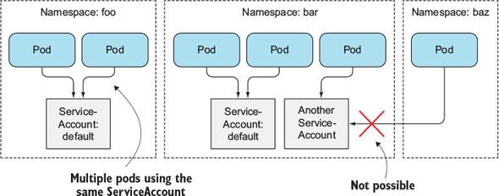
Securing the API
Namespaces are your logical boundaries
Sources:
https://learning.oreilly.com/library/view/kubernetes-in-action/9781617293726/kindle_split_024.html
Notes:
ServiceAccounts are resources just like Pods, ConfigMaps, Routes, and by default are scoped to a Namespace. A default ServiceAccount is automatically created for each namespace. Within the pod the authentication token for the ServiceAccount is located in /var/run/secrets/kubernetes.io/serviceaccount/token
Each pod is associated with exactly one ServiceAccount but multiple pods can use the same ServiceAccount. If you do not provide a ServiceAccount in the pod’s manifest the default one is used.

Slide 16
Kubernetes API Actions and HTTP Methods
Verb (API) HTTP Method
Securing the API
The possible actions an identity can perform are documented
How do we know if an identity can perform these action?
get | GET
list | GET
watch | GET
create | POST
update | PUT
patch | PATCH
delete | DELETE
deletecollection | DELETE
Notes:
Remember we talked previously about API verbs and how they map/relate to HTTP methods. We utilize the user, group, and serviceaccount to deal with authentication; ensuring you are who you say you are. How do we deal with whether or not you can do (verb) what you are trying to do? RBAC

Slide 17
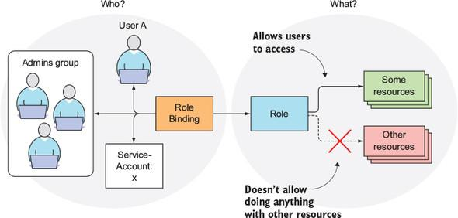
RBAC: Defining who can do what and where
Securing the API
Sources:
https://learning.oreilly.com/library/view/kubernetes-in-action/9781617293726/kindle_split_024.html
Notes:
Roles and ClusterRoles specify which verbs can be performed on which resources. RoleBindings and ClusterRoleBindings bind the roles to specific users, groups, or ServiceAccounts. Roles define what can be done, bindings define who can do it.

Slide 18
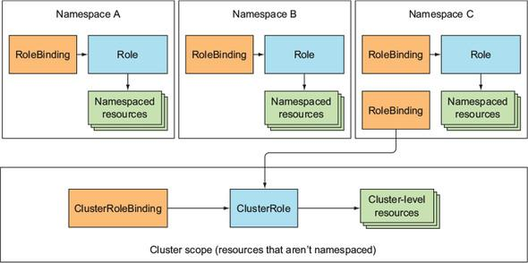
Role and RoleBinding Scopes
Securing the API
Sources:
https://learning.oreilly.com/library/view/kubernetes-in-action/9781617293726/kindle_split_024.html
Notes:
multiple Roles/RoleBindings can exist in a single namespace, multiple ClusterRoles/ClusterRoleBindings can be created.
although namespaced, RoleBindings can point to ClusterRoles

Slide 19
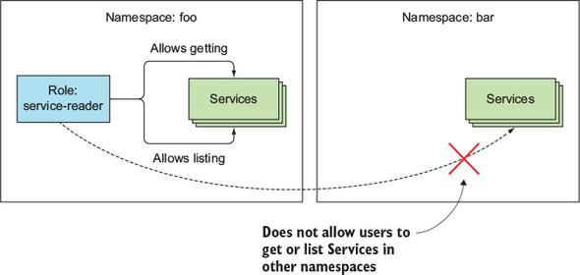
Ensuring namespaces isolation
Securing the API
Sources:
https://learning.oreilly.com/library/view/kubernetes-in-action/9781617293726/kindle_split_024.html
Notes:
these actions are allowed against these objects within this namespace

Slide 20
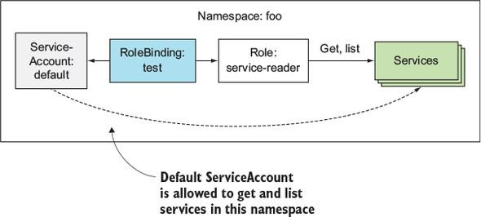
Accessing resources in your namespace
Securing the API
Sources:
https://learning.oreilly.com/library/view/kubernetes-in-action/9781617293726/kindle_split_024.html
Notes:
utilizing the RoleBinding we are now allowing the specific ServiceAccount, default here, to perform the actions on the objects within this namespace

Slide 21
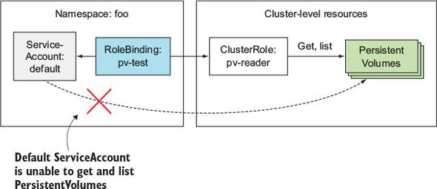
Attempting to access cluster-scoped resources
Securing the API
Sources:
https://learning.oreilly.com/library/view/kubernetes-in-action/9781617293726/kindle_split_024.html
Notes:
You can add ClusterRoles as targets for RoleBindings, but you cannot access cluster-scoped resources because RoleBindings imply namespace isolation and PersistentVolumes are not namespaced scoped.

Slide 22
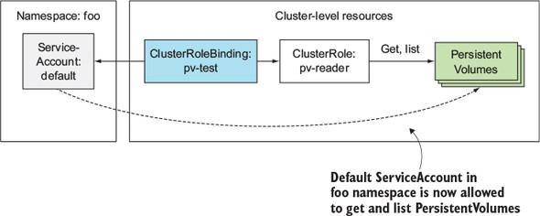
Successfully accessing cluster-scoped resources
Securing the API
Sources:
https://learning.oreilly.com/library/view/kubernetes-in-action/9781617293726/kindle_split_024.html
Notes:
In order to perform actions against Cluster-level Resources a ClusterRoleBinding and ClusterRole combination is required.

Slide 23
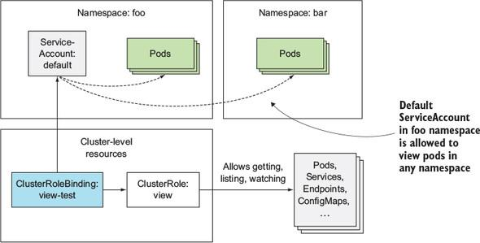
Successfully accessing cluster-scoped resources
Securing the API
Sources:
https://learning.oreilly.com/library/view/kubernetes-in-action/9781617293726/kindle_split_024.html
Notes:
ClusterRoleBindings and ClusterRoles are themselves cluster-level resources so when you utilize them for say allowing get, list, and watch against namespace resources like Pods, Services, Endpoints, etc, you allow the associated ServiceAccount(s) to perform these actions against the referenced resources in all namespaces.

Slide 24
Key Takeaways
Securing the API
Each HTTP request goes through various filters and if they pass additional context is added or if they fail a proper status is returned.
Your kubeconfig can be used to access multiple clusters at once using what is known as a context and certain access based on the context is given.
Pods run under the default ServiceAccount, which is created for each namespace automatically, unless changed.
Roles and ClusterRoles define what actions can be performed on which resources.
RoleBindings and ClusterRoleBindings bind Roles and ClusterRoles to users, groups, and ServiceAccounts.

Slide 25
Questions?

